Slide 1
Welcome to the 46th Meeting of the ISCWSA
Jonathan Lightfoot – Program Chair

Slide 2
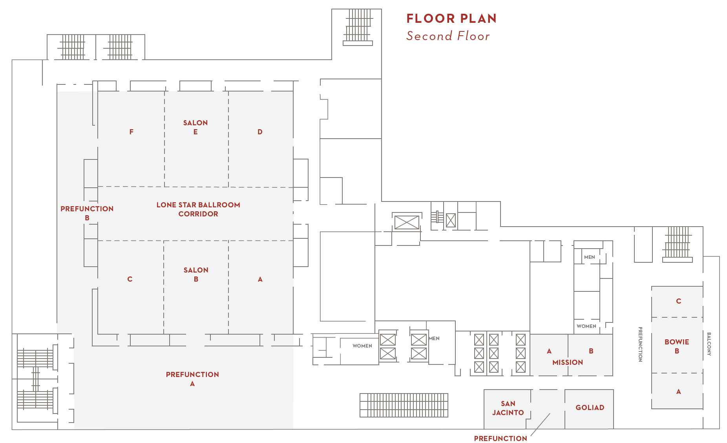
SAFETY & LOGISTICS BRIEFING
Exits
Alarms
I.C.E. – In Case of Emergency
Medical
Muster Area
Restrooms
Lunch Location

Slide 3
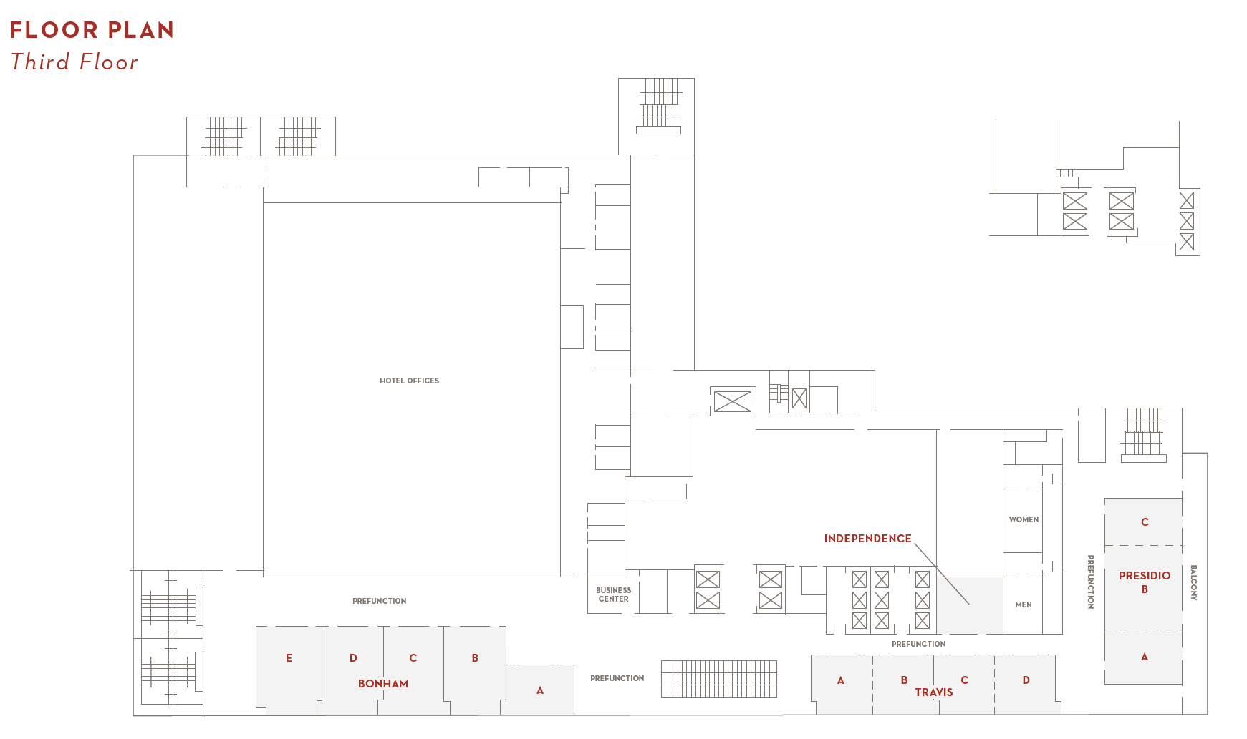
SAFETY & LOGISTICS BRIEFING
Exits
Alarms
I.C.E. – In Case of Emergency
Medical
Muster Area
Restrooms
Lunch Location

Slide 4
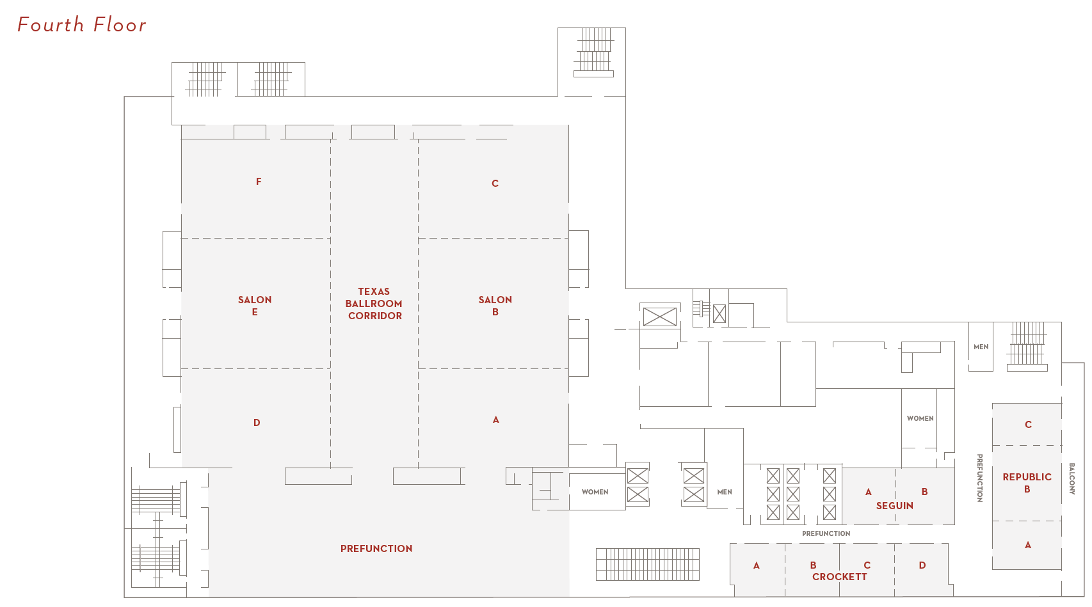
SAFETY & LOGISTICS BRIEFING
Exits
Alarms
I.C.E. – In Case of Emergency
Medical
Muster Area
Restrooms
Lunch Location

Slide 5
46th Meeting Program Chair
Jonathan Lightfoot
SPE WPTS Program Chair (2016-2017)
SPE WPTS Chair (2018-2019)
Occidental Oil & Gas Corporation
  Global Directional Drilling Specialist (Role)
  Performance Drilling Community of Practice Leader (Job)
  Sr. Engineering Consultant (Official Title)

Slide 6
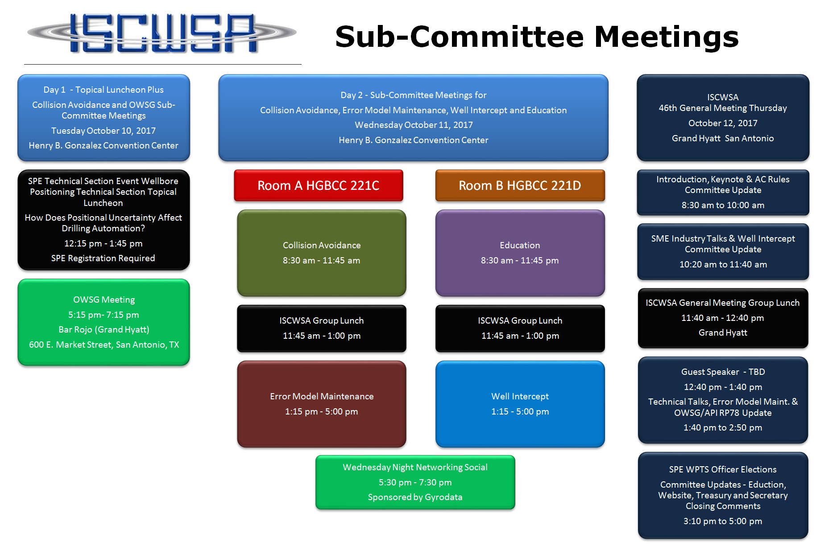
Technical Program

Slide 7
General Meeting Program

Slide 8
General Meeting Program

Slide 9
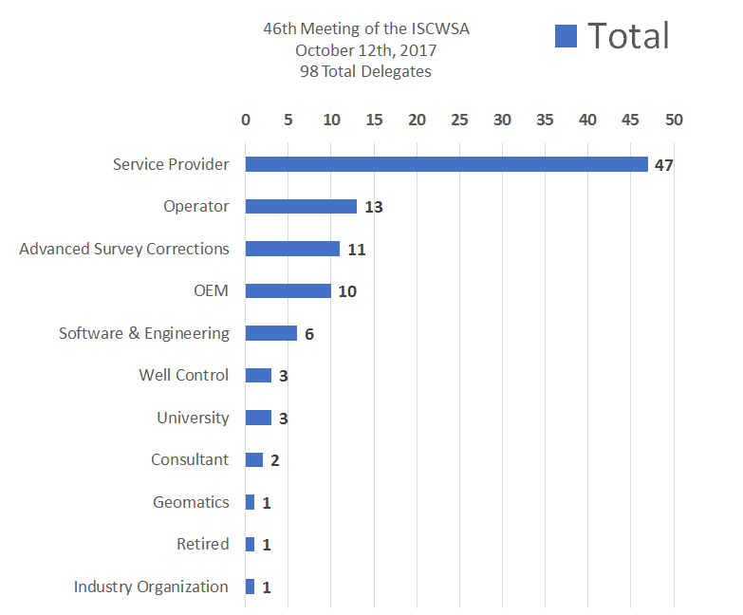
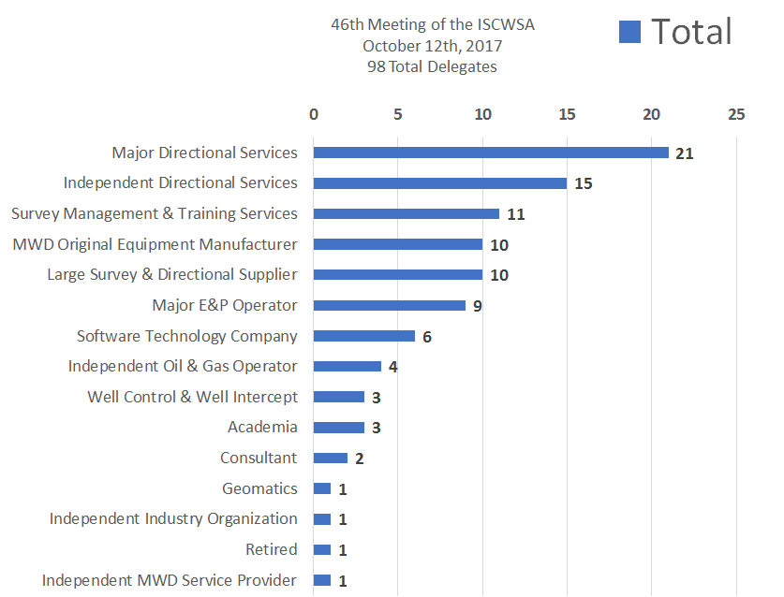
Today’s Registered Attendees – 98 Total

Slide 10
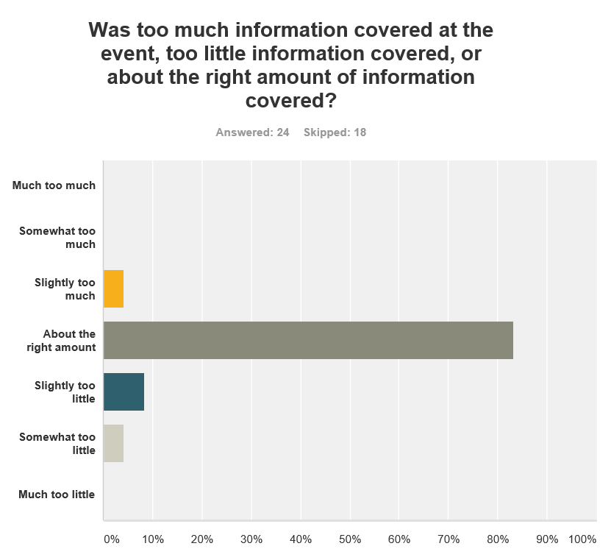
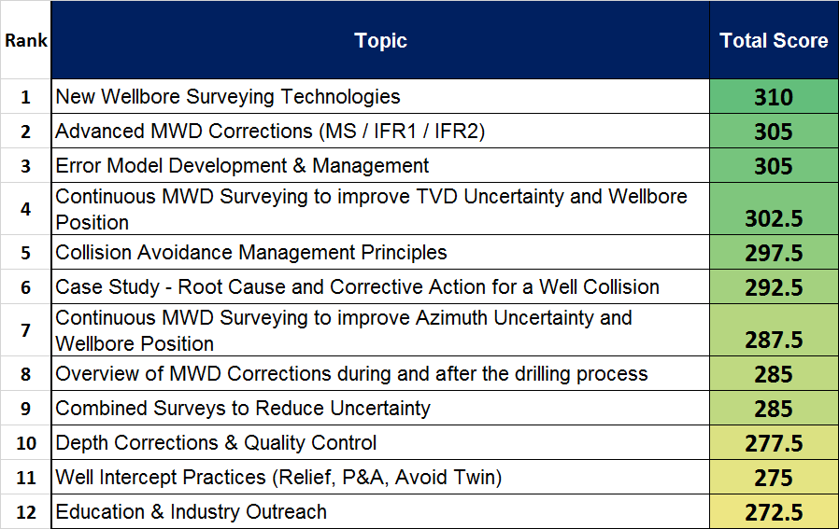
Recent Survey Results

Slide 11
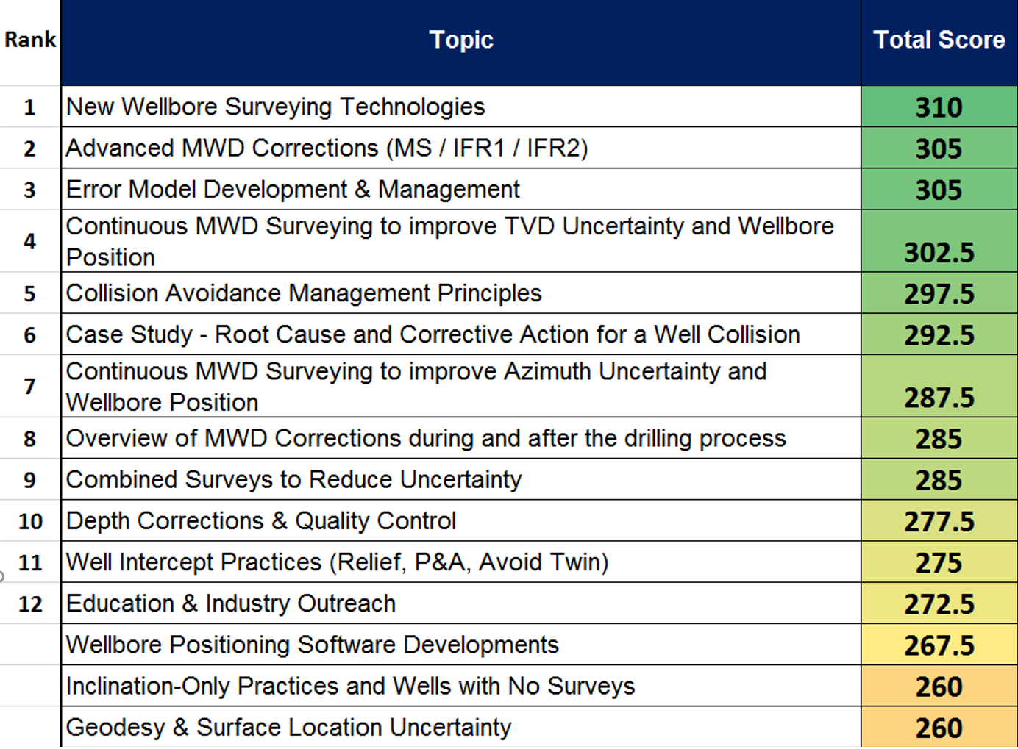
Survey Results – Important Future Topics

Slide 12
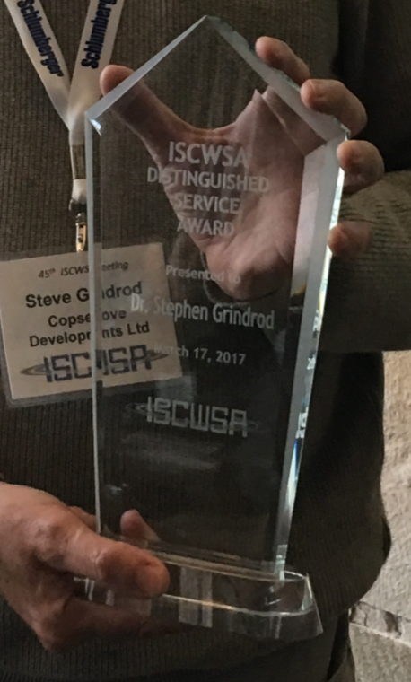
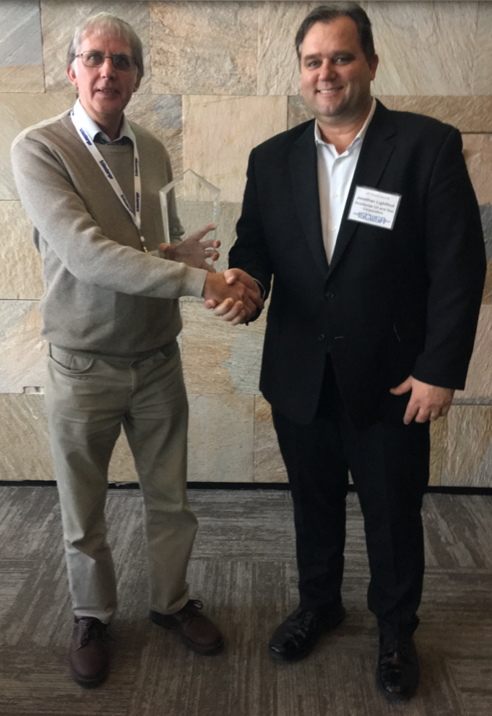
Distinguished
Service Award
ISCWSA 45th Meeting
The Hague, The Netherlands
Dr. Stephen Grindrod

Slide 13
2017 46th Meeting
Distinguished Service Award
?

Slide 14
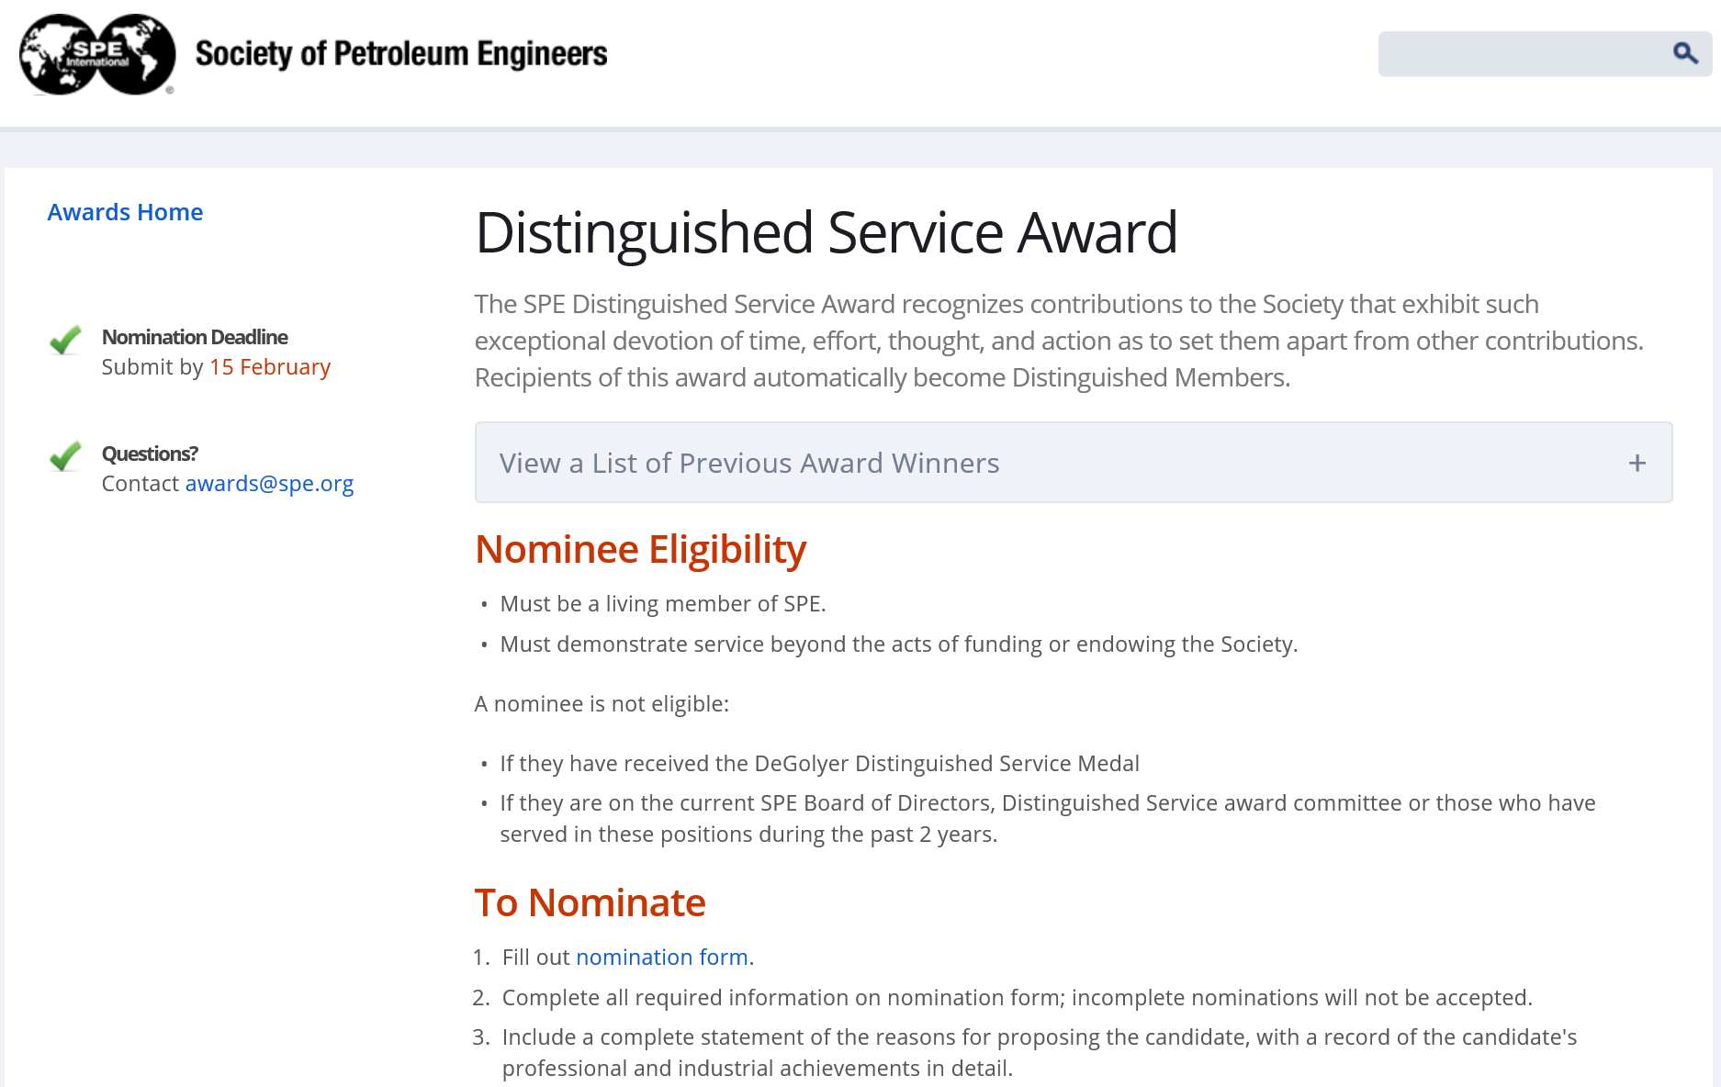
SPE Distinguished Service Award

Slide 15
A Special Thank You for our Event Sponsors!

