Slide 1
Drilling Data Quality & Uncertainty
Subcommittee DSATS, WPTS and DUPTS
ISCWSA Conference April 14-15, 2021

Slide 2
SPE DDQUD sub-committee
Official designation:
Drilling Data Quality and Uncertainty Description Subcommittee
Sub committee of:
DSATS (Drilling System Automation Technical Section)
WPTS (Wellbore Positioning Technical Section)
DUPTS (Drilling Uncertainty Prediction Technical Section)
Scope of work:
The primary mission of this Drilling Data Quality and Uncertainty Description Subcommittee is to increase the awareness and understanding in the drilling community on how to describe drilling data quality and uncertainty.
It is not the intention to repeat work undertaken by OGDQ / API 8 and IADC ART DCS Sensor Stewardship initiatives. Rather, to enable consistent description of data quality / uncertainty on key drilling data.
Method:
List up typical user stories and associated key drilling data
Rank the criticality of the data
Identify the most critical data
Find a method to describe the data quality and uncertainty

Slide 3
User story
A user story is an informal, natural language description of one or more features of a software system. User stories are often written from the perspective of an end user or user of a system.​
User stories are a type of boundary object. They facilitate sensemaking and communication; that is, they help software teams organize their understanding of the system and its context​
(https://en.wikipedia.org/wiki/User_story)​
​
User story documents can be found here: https://dsabok.org/drilling-data-quality-uncertainty/​
It is the 3rd edition of the document​
It contains: 111 user stories​

Slide 4
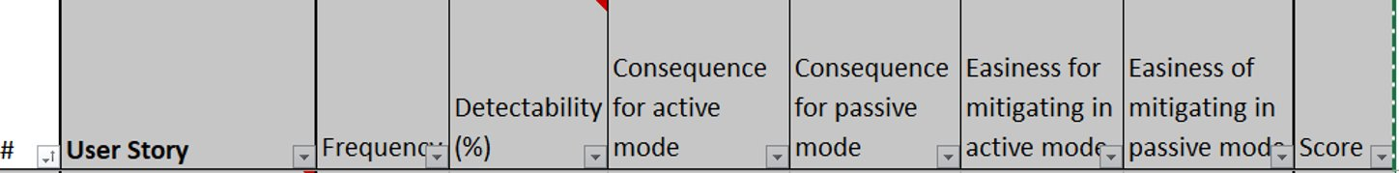
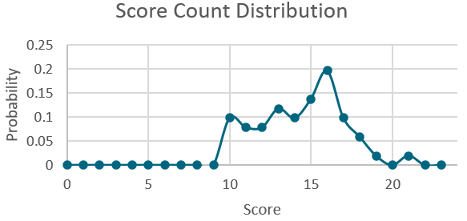
Searching for «low hanging fruits»
How to rank the different «user stories»?​
The asset criticality ranking approach: three important elements​
  the consequence of failure​
  the reliability of the asset​
  The detectability of the fault condition​
Furthermore, a split between active and manual mode​
Each evaluation can give a maximum of 4 points, therefore highest score is 24​
The highest ranking “user stories” are those which have a large impact and are “easy” to solve​
Maximum possible score​ | 24,0​
Minimum Possible Score​ | 0,0​
Highest score​ | 21,0​
Lowest Score​ | 9,0​
Average Score​ | 14,2​
Std Dev.​ | 2,7​

Slide 5
Use Cases
A use case is a list of actions or event steps typically defining the interactions between a role/actor and a system to achieve a goal.
Use cases are a technique for capturing, modelling and specifying the requirements of a system. A use case corresponds to a set of behaviors that the system may perform in interaction with its actors, and which produces an observable result that contribute to its goals. Actors represent the role that human users or other systems have in the interaction.
(https://en.wikipedia.org/wiki/Use_case)
The scope of a use case is defined by subject and by goals:
The subject identifies the system, sub-system or component that will provide the interactions
The goals can be structured hierarchically, taking into account the organizational level interested in the goal, and the decomposition of the user's goal into sub-goals. The decomposition of the goal is performed from the point of view of the users, and independently of the system, which differs from traditional functional decomposition.
Example in the form of a casual description
Title (goal)
Primary actor
Stakeholder
Scope
Level
Story: the body of the use case is simply a paragrpah or two of text, informally describing what happens

Slide 6
User Story #20
“Tabulations of well survey data is typically to 2 decimal places when the uncertainty, at deeper depths, is in whole meters / feet and multiples thereof. This is misleading to the end user and subsurface modelling (especially cross correlation of pressures) suffers badly. A common representation of uncertainty on shared TVD data is needed to ensure end users take into account the real uncertainty.”
17 use cases have been extracted:

Slide 7
Semantic Graph to describe relations between data
What is a semantic network?
A collection of facts expressed in the form: subject verb object
These facts can be linked to each other’s therefore generating a directed graph
Node #2
Verb #1
Node #1
Verb #2
Node #3
Node #4
Verb #3
Verb #4
The semantic graphs capture how data are related:
  This describes relations between the different data entity
  This describes the process that underly the generation of the data
  Therefore there is a computer readable description of work processes
What is the function of the nodes in the semantic graphs?
  It is a container that can point to where the actual data resides
  It can contain additional information, e.g., about uncertainty and quality, that was not described in the original data format

Slide 8
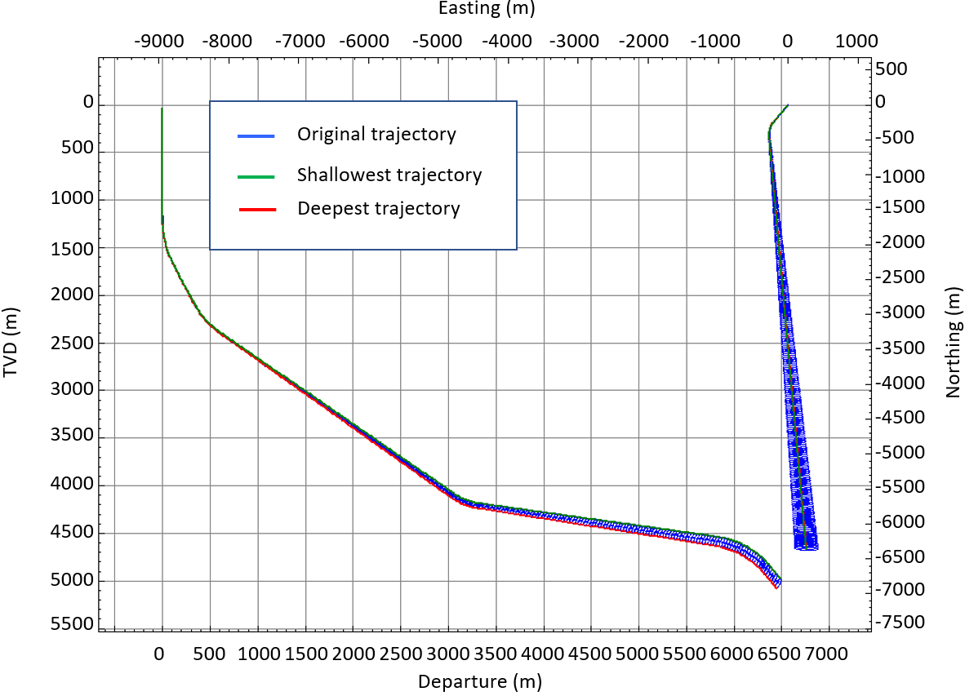
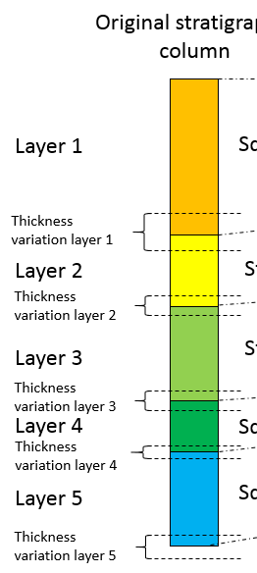
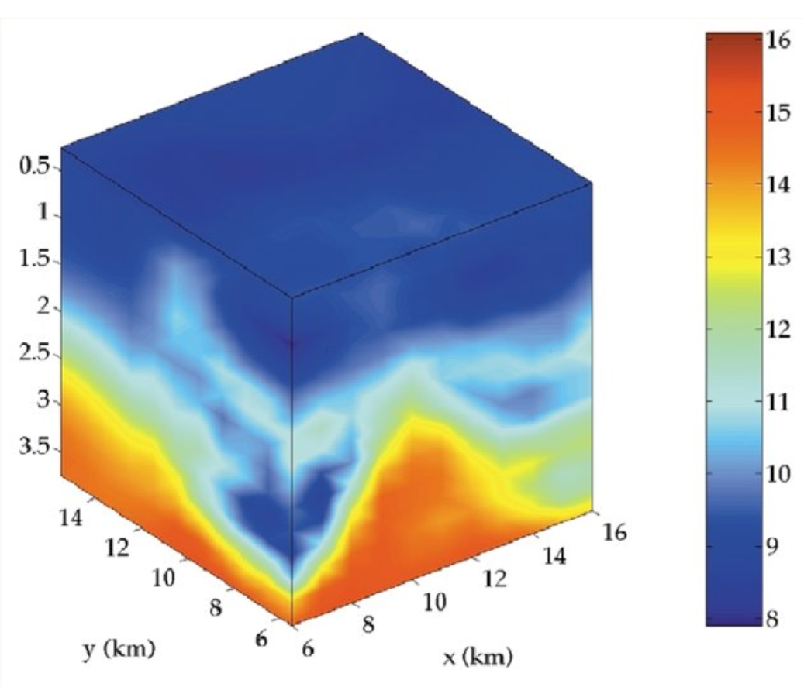


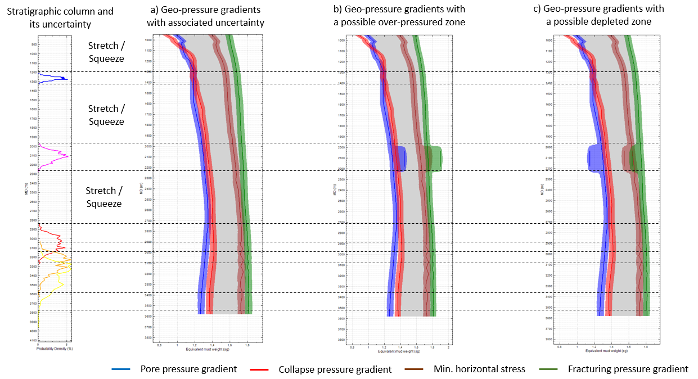
User story #20, Use case #3 “Geo-mechanician convey prognosed geo-pressures with uncertainty”
Use case (goal): convey TVD depth uncertainty
Primary actor: Geo-mechanician
Stakeholders: Geo-Modeler, Drilling Engineer
Scope: Geo-mechanical software, Well path generation software, earth modelling software
Level: summary or user goal
Brief: geo-pressure gradients are conveyed with uncertainty
Convey Planned Well Path
Earth Modelling Software
Well path generation Software
Geo-modeler
Drilling Engineer
Convey TVT uncertainty
Geo-mechanical Software
Directional Driller
Convey ppg, cpg, fpg with uncertainty
Drilling Supervisor
Summary
Geo-mechanician
Mud logger

Slide 9
Confidence factor #1
Is estimated with confidence
Is estimated with confidence
Is estimated with confidence
Trajectory #4
Trajectory #5
Stratigraphic column #1
Is lower vertical bound
Is higher vertical bound
Has a
Is estimated from geological stack
Wellbore #1
Trajectory #1
Is estimated with confidence
has a
Has a
Belongs to
Geo-pressure prognosis #1
Depth Stack #1
Planned operation #1
Is estimated from geological stack

Slide 10
Conclusion
Drilling data quality and uncertainty depends on the interrelation with other data elements
  The workflow to derive the data is important to describe how uncertainty and quality shall be propagated
Semantic graph allows to capture these interrelations
  They are computer readable
  It is possible to perform analyses
    Detect inefficiencies
    Discover missing steps or information
  It is also possible to extract “stencil” workflows that can be reused and therefore help streamlining work efforts and document process quality

Slide 11
Thank you for your attention
Any questions?

