Slide 1

Separation Factor – Where are We?
(A supplement to SPE-200475-PA)
Harry Wilson, Baker Hughes
Jon Bang, Gyrodata
Erik Nyrnes, Equinor ASA

Slide 2
Separation Factor: Contents
Current Status - SF type Anti-Collision Rules
  Lack of standardization, and widespread misunderstanding
Most correct SF formula
  No method is perfect
Direct Hit vs Unintentional Crossing
  Probability volumes
Conclusions

Slide 3
Separation Factor: What is it?
Most widely used criterion for managing well separation
Basic form: SF = D/kσ_{s}
Limit value SF_{crit} sets an assumed safe distance between wells
  SF_{crit} defines MASD between the two points of interest
SF relates to the probability of unintentional crossing, not direct hit

Slide 4
Separation Factor: Relates to Unintentional Crossing
Unintentional
crossing
volume, V_{UC}
Direct hit volume, V_{DH}
1σ
1σ
2σ
3σ
2σ
4σ
3σ
4σ
V_{UC} extends to infinity
beyond planar boundary,
and perpendicular to
well-to-well line
(Adapted from SPE-184644-PA)

Slide 5
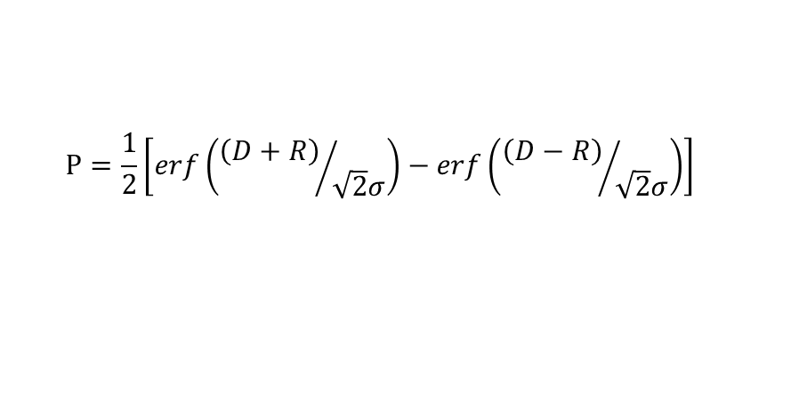
Separation Factor: Direct hit probability by 1D formula
$$P=\frac{1}{2}\left[erf\left({\left(D+R\right)}/{\sqrt{2}σ}\right)−erf\left({\left(D−R\right)}/{\sqrt{2}σ}\right)\right]$$
SPE-116155-PA, normal distribution assumed
(Similar formulas presented in SPE-36484-PA)
P = red area
1σ
σ: standard deviation of combined uncertainty
D: centre-to-centre distance
R: sum of wellbore radii
D
2R

Slide 6
Separation Factor: Direct hit probability by 1D formula
Offset well
2R
The 1D probability is not the
probability of a point on the Reference
well hitting the offset well . . .
. . . but the probability of hitting
the Offset well when drilling
towards and past it.
D
2R
Reference well
D
Offset well
2R
D
Reference well
Planar slab of thickness 2R,
plane extending to «infinity»

Slide 7
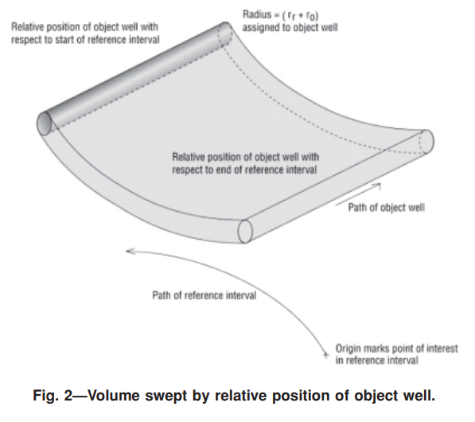
Separation Factor: Direct hit probability by 1D formula
For curved wellpaths,
the volume will curve
1D formula does not apply
(Illustration: SPE-116155-PA)

Slide 8
Separation Factor: Relates to Unintentional Crossing
Unintentional
crossing
volume, V_{UC}
Direct hit volume, V_{DH}
2σ
1σ
4σ
3σ
1σ
2σ
3σ
4σ
The probability of one point hitting an offset well can be found by:
- Monte Carlo simulations
- Divide into segments; sum(PDF_{centre} * V_{segment})
... NOT the 1D formula.
V_{UC} extends to infinity
beyond planar boundary,
and perpendicular to
well-to-well line

Slide 9
Separation Factor: Current Status
Many variants in use, lack of standardisation
SPE WPTS recommendation (SPE-187073-PA) still not widely adopted
Possible reasons:
  Inertia/conservatism
  Benefits are unclear
  Implications of change are unclear
  Confusion about the meaning/interpretation of SF formulas

Slide 10
Separation Factor: Evaluation of Options
SPE-200475-PA evaluated all commonly used methods
Supports the SPE WPTS rule as the currently most correct
Also identifies shortcomings in the overall methodology
  Point selection method: unsolved
  Incorporation of wellbore direction info: unsolved
An improved SF will still relate to unintentional crossing, not just direct hit

Slide 11
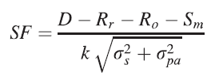
Separation Factor: Current Best Formula
SPE-187073-PA:
  For verification, and derivation of σ_{s} from statistical principles, see SPE-200475-PA
All other approaches may be optimistic, pessimistic, or both
  This is not evident from the results
  Discrepancies may be large/significant

Slide 12
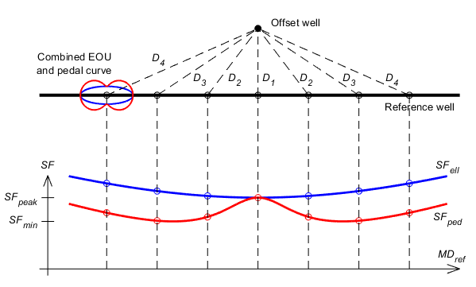
Separation Factor: Non-intuitive results
Red curve is correct
  Blue curve uses incorrect SF formula
  Blue curve is too optimistic
The inverse of the SF curve relates to crossing probability, not direct hit
SF
Illustration: SPE-200475-PA

Slide 13
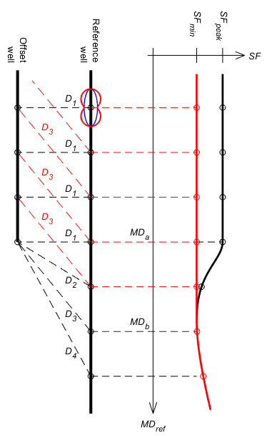
Separation Factor: Non-intuitive results
SF
Red curve is correct
  Black curve applies deficient point selection
  Black curve is too optimistic
Illustration: SPE-200475-PA

Slide 14
Separation Factor: Conclusions
We must fully understand our SF rules, and not rely on undocumented practice or claims, or intuition
SF formulas of the form D/kσ_{D} all relate to unintentional crossing, not direct hit
The SPE WPTS rule (SPE-187073-PA) applies the currently best formula, but is still flawed
Its weaknesses are common to all SF formulas; some are near to a solution, some are not
The ISCWSA must achieve a common understanding of the current status, then work to solve the remaining challenges

Slide 15
Thank you.

