Slide 1
iscwsa.net Webmaster Update
philip.harbidge@pathcontrol.com

Slide 2
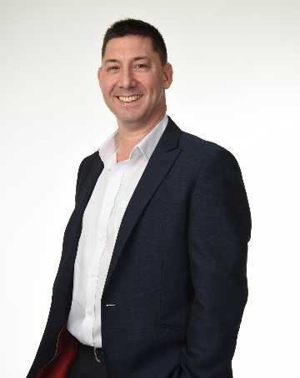
Phil Harbidge Presenter
Phil HARBIDGE - PathControl, General Manager - Kuala Lumpur
20+ years Wellbore Positioning
Wellplacement, CA, Risk Assessment, Well QAQC & Optimization
ISCWSA Webmaster
QAQC Sub-committee Chair,
Drilling Quality and Uncertainty Description, Error model, Collision Avoidance, Well Intercept and Education
Worked :
Civil Engineer, Marine Surveyor - Halliburton, Baker Hughes and Schlumberger: DD Service Companies
PathControl : Intercept Relief Well and Advanced Survey Management

Slide 3
Enhancements
Join ISCWSA Group Form – Completed
Sponsor ISCWSA - Completed
Join ISCWSA Sub-Committees Form – Completed
Registration - Completed
Payments – Fully Functional
Notes:
15 meetings held to date. Writing and optimizing the content to match the required API format

Slide 4
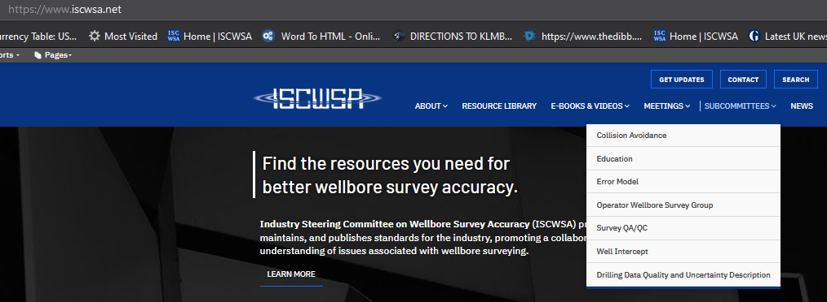
Content Management
Sub-Committee Chair Persons are managing their content

Slide 5
30-Day Traffic
Notes:
942 Page visits
2479 clicks on events

Slide 6
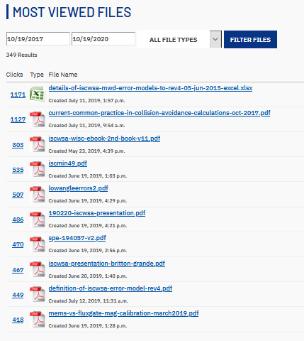
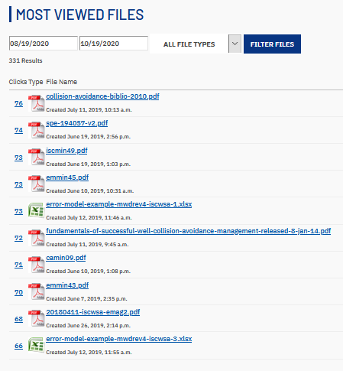
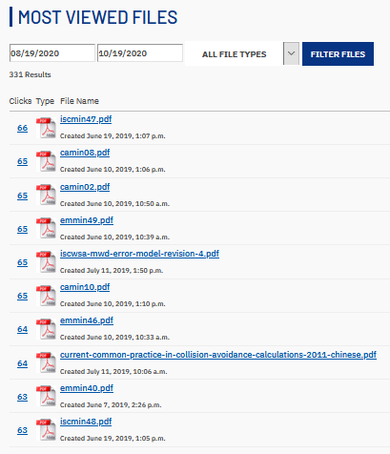
Most Viewed
Notes:
The Most Viewed file on our website is the Rev 4-05-jun-2015-excel file. Soon to be eclipsed by the Rev 5 excel file,

Slide 7
Notes:
New
CLICK GET UPDATES,, CONTACT US and SEARCH Buttons are new and allow readers to keep in touch, ask to become a member and give us feedback.
Join ISCWSA and Sub-Committees is coming soon

Slide 9
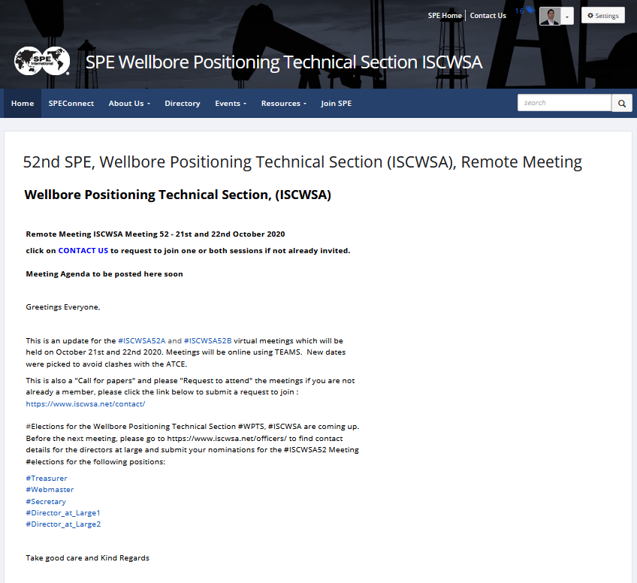
SPE.org WPTS
Notes:
SPE Technical Section website links directly to our ISCWSA.net website

Slide 10
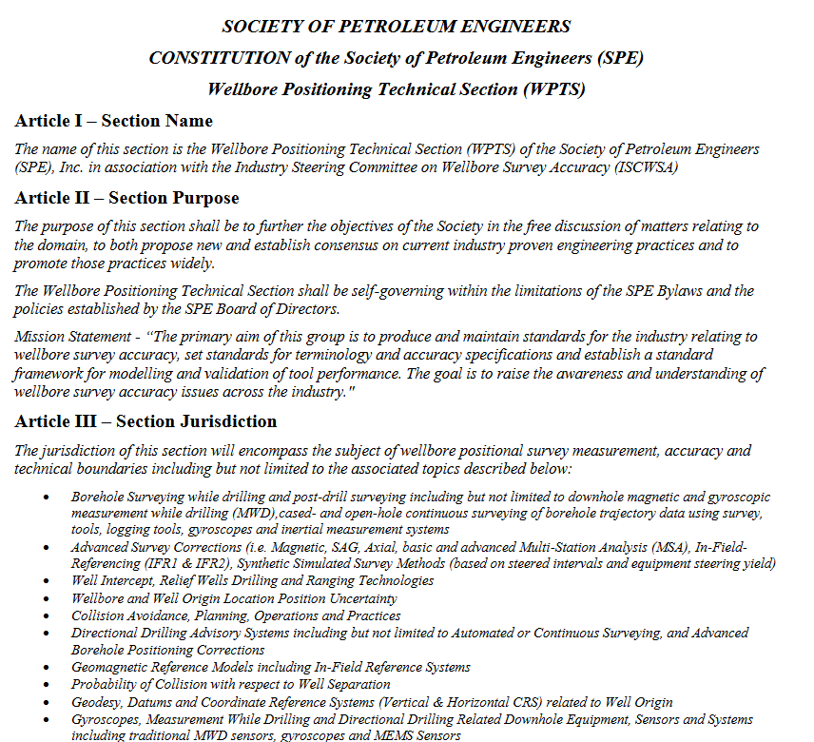
Constitution
Constitution
Voted in ISC50
Calgary Link on Website

Slide 11
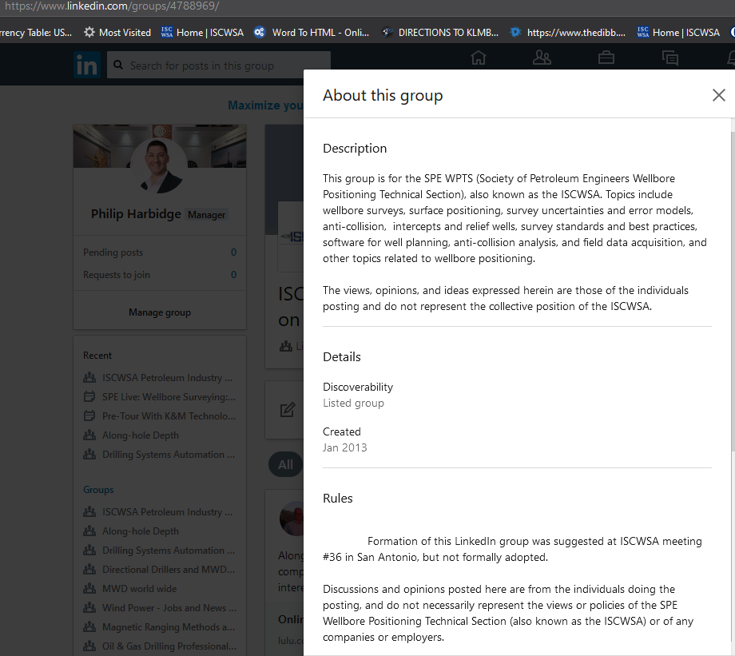
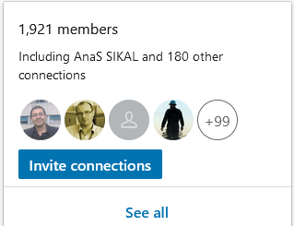
Linkedin

Slide 12
Questions

