Slide 1
Survey QAQC Sub-Committee Update
philip.harbidge@pathcontrol.com

Slide 2
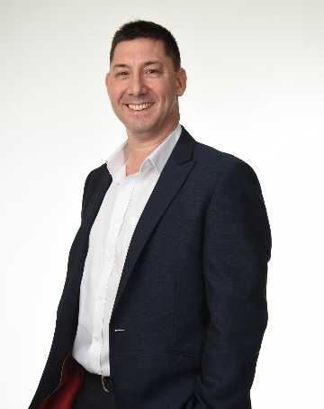
Phil Harbidge Presenter
Phil HARBIDGE - PathControl, General Manager - Kuala Lumpur
20+ years Wellbore Positioning
Wellplacement, CA, Risk Assessment, Well QAQC & Optimization
ISCWSA Webmaster
QAQC Sub-committee Chair,
Drilling Quality and Uncertainty Description, Error model, Collision Avoidance, Well Intercept and Education
Worked :
Civil Engineer, Marine Surveyor - Halliburton, Baker Hughes and Schlumberger: DD Service Companies
PathControl : Intercept Relief Well and Advanced Survey Management

Slide 3
API RP-78 Chapters Update
DEPTH Chapter – FINISHED
GYRO – Chapter FINISHED
MWD – Chapter FINISHED
Gyro-MWD outstanding 2 points pending feedback - Gyrodata and SDI
2018 First meeting on 5th Oct
2020 Meetings :
10, 11, 12, 13 and 14 1st -19th May
15 2nd – June
E-Book Meetings
16 and 17 5th possibly 12th Nov
Notes:
15 meetings held to date. Writing and optimizing the content to match the required API format

Slide 4
E-Book
DEPTH, GYRO, MWD and Data Survey Record (DSR)
– multiple documents and references
First Meeting in Nov 2020 –First Draft June 2021 (ISCWSA54 or earlier)

Slide 5
Thanks
Thanks to all the volunteers who are working on this project
Manufacturer & Calibration Experts: BenchTree, Scientific Drilling, Halliburton, Gyrodata, Schlumberger, Baker Hughes, Weatherford and JAE Operator Experts: Chevron, Oxy, ConocoPhillips, BP, Total, Devon Energy, ExxonMobil …. Service Company Experts: Halliburton, Baker Hughes, Schlumberger, Weatherford, Depth Solutions, Mostar Drilling, SuperiorQC, Independent Consultants, EOG Resources, PathControl….
Notes:
Thanks to all of you who have dedicated your personal / work time to the project

Slide 6
Questions

Slide 8
Drilling Data Quality and Uncertainty Description SPE Sub-Committee Update
Eric Cayeux erca@norceresearch.no philip.harbidge@pathcontrol.com

Slide 9
Steering Committee Joint Sub-Committee
DSATS (Drilling System Automation Technical Section)
WPTS (Wellbore Positioning Technical Section, ISCWSA)
DUPTS (Drilling Uncertainty Prediction Technical Section)
Eric Cayeux (NORCE Norwegian Research Centre)
Moray Laing (Halliburton)
Gerhard Thonhauser (TDE)
John Macpherson (Baker Hughes)
Pradeep Annaiyappa (Nabors)
Carlos Damski (Genesis Petroleum)
Philip Harbidge (PathControl)
Notes:
Join Sub-Committee DSATS WPTS and DUPTS with representatives meeting from each
This is a chance to

Slide 10
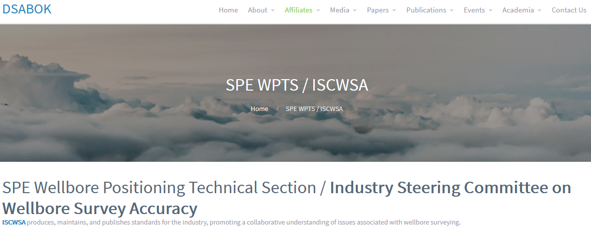
Update
10
Notes:
Attendees from the THREE Sub-Committees are listed in this table
Minutes and presentations copied to the Sub-Committee Chair Persons

Slide 11
Activity
Four meetings to date in 2020 (AUG – SEPT)
Working up User Stories and Pain Points Identifying a Specific Drilling Scenario Risk Event to form User Cases
Group progress :
Modify descriptions clearly identifying risk context
Group to Rank User Cases
Top Ranking Cases will be worked up into a document :
Data Description
Context of Drilling Data Risk
Associated Uncertainty
Minutes and Presentations hosted here https://dsabok.org/
Notes:
4 meetings held to date
The objective is to identify Drilling Scenario Risks and create a real User Story
The User Stories are then turned into more formal User Cases
All cases are ranked
Top cases are written up with data description, context and associated uncertainty

Slide 12
Scope
The primary mission is to increase the awareness and understanding in the drilling community on how to describe drilling data quality and uncertainty.
It is not the intention to repeat work undertaken by OGDQ / API RP78 and IADC ART DCS Sensor Stewardship initiatives. Rather, to enable consistent description of data quality and uncertainty on key drilling data.
Notes:
Scope

Slide 13
Project Methodology
List typical use cases and associated key drilling data
Rank the criticality of the data
Identify the most critical data
Identify industry experts familiar with the data
Sub-team with these experts to specify how data quality and uncertainty can be described
Publish use cases
Notes:
Methodology

Slide 14
Questions

