Slide 1
A case for look-up tables for magnetic field error
Susan Macmillan
ISCWSA error sub-committee meeting
19 March, London

Slide 2
Magnetic terms in ISCWSA and OSWG MWD error models
Declination (D)/magnetic azimuth with horizontal intensity (H) dependency = 2 terms (DEC, DBH), dD = √(DEC² + (DBH/H)²)
+1 term for inclination (I)/magnetic dip (MDI in +AX models only)
+1 term for total intensity (F)/Btotal (MFI in +AX models only)
= 4 terms
References
Williamson, 2000. SPE67616
http://www.copsegrove.com/Documents/ISCWSA_MWD_Error_Models_28-Jul-2014.xlsx
http://www.copsegrove.com/Documents/OWSG_Set_A_Standard_Error_Model_Set_11-Apr-2014.xls
Maus et al presentation 30 Oct 2014 ISCWSA

Slide 3
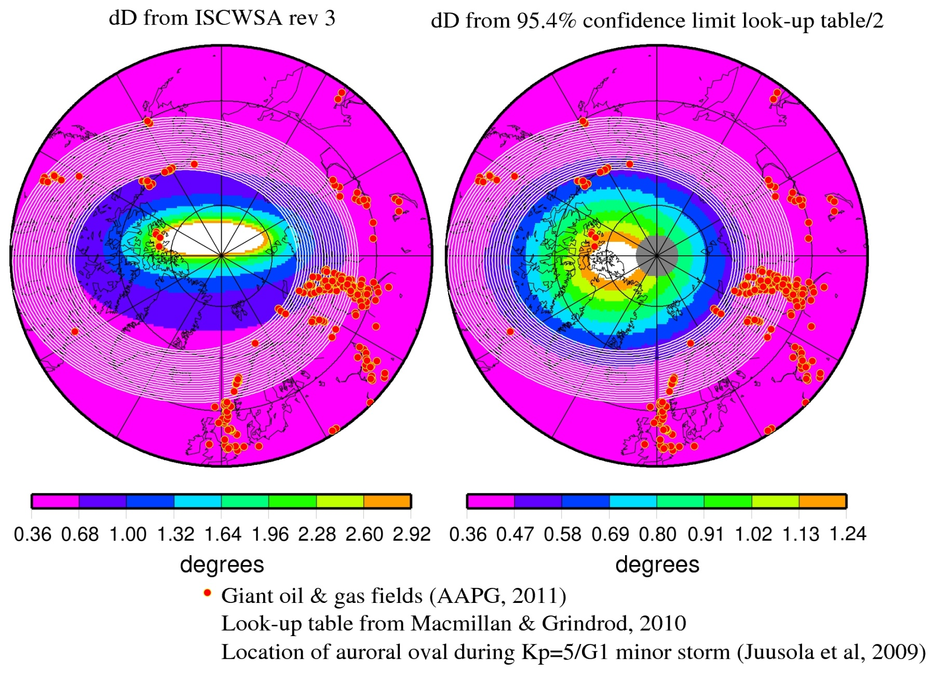
D error in northern polar region from 2-term model and 1-term model with value from look-up table
H dependency for D error does not map auroral oval region accurately
Values at high latitudes too high from 2-term model
Range of colour scale spans all oil fields

Slide 4
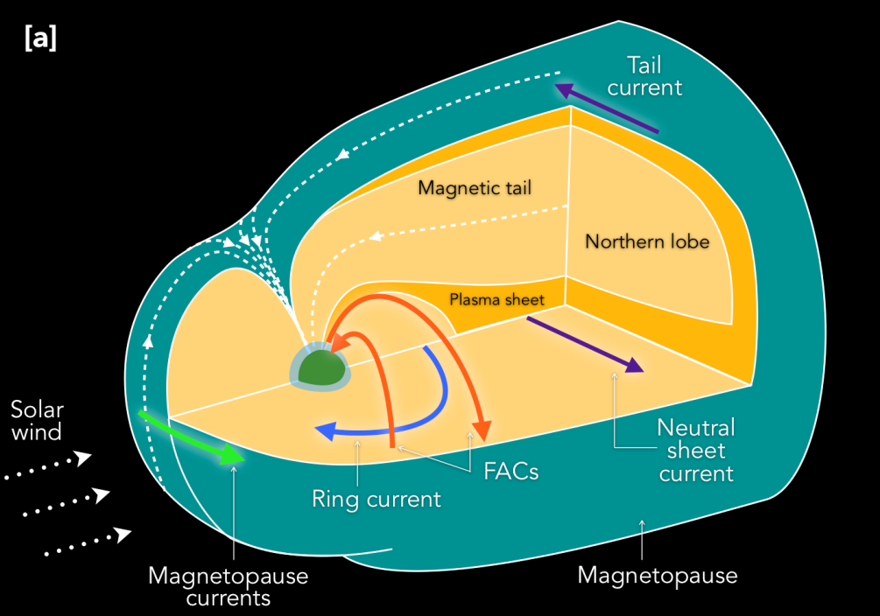

Polar currents considerably more complicated than E-W auroral electrojet, especially during disturbed times
Major magnetospheric current systems and their linkage…
via field-aligned currents to the ionosphere
Estimating their effects on D error with 1-term look-up table approach more accurate than with basic 2-term H dependent approach

Slide 5
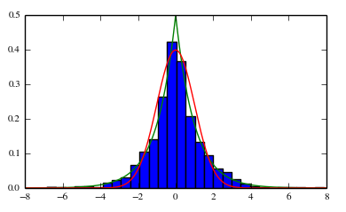
Why look-up table should be based on 95.4% confidence limits ÷ 2
Magnetic data do not follow a Gaussian/normal distribution
Laplacian distribution is better, particularly near the extremes which are more important
Industry error models assume Gaussian distributions for all error sources
Output 1σ values multiplied up for final error ellipsoids assuming 2 x 1σ = 95.4% confidence, 3 x 1σ = 99.7%, as for a Gaussian distribution
Input magnetic error terms should therefore scale correctly, and be robust
95.4% confidence limits for magnetic field >> 2 x 1σ, particularly for declination
To be on safe side use 95.4% confidence limits ÷ 2
Laplacian
Gaussian

Slide 6
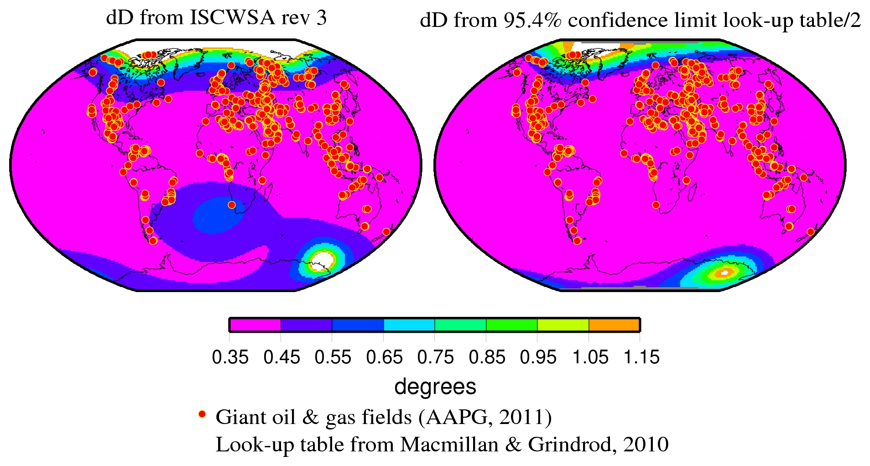
H dependency for D error also not good elsewhere…
Increase in error here due to weak H too high
Common colour scale

Slide 7
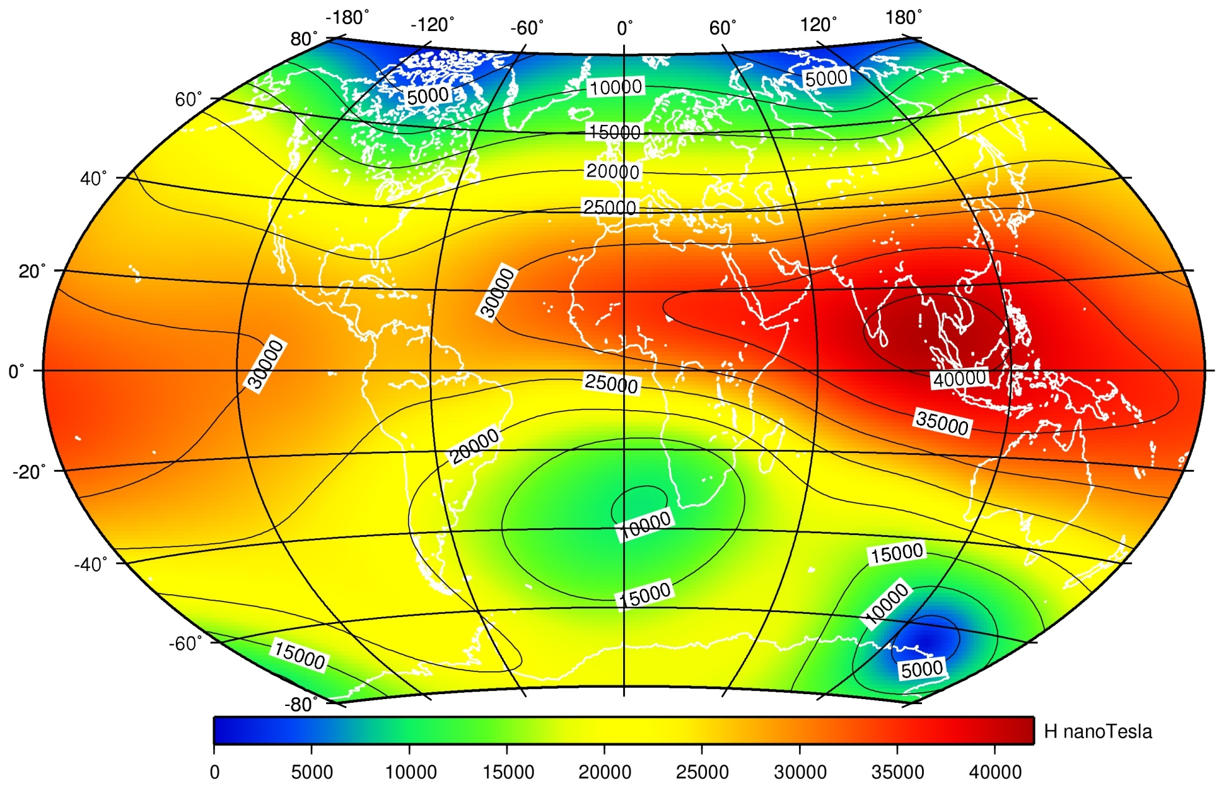
Horizontal intensity map
2015.0

Slide 8
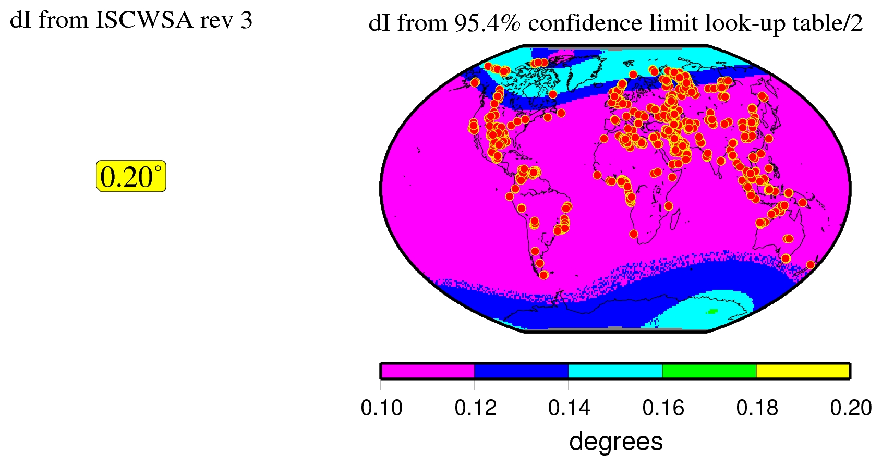
Why one value for magnetic dip term not good…
Too high, excludes effects of polar current systems
Common colour scale

Slide 9
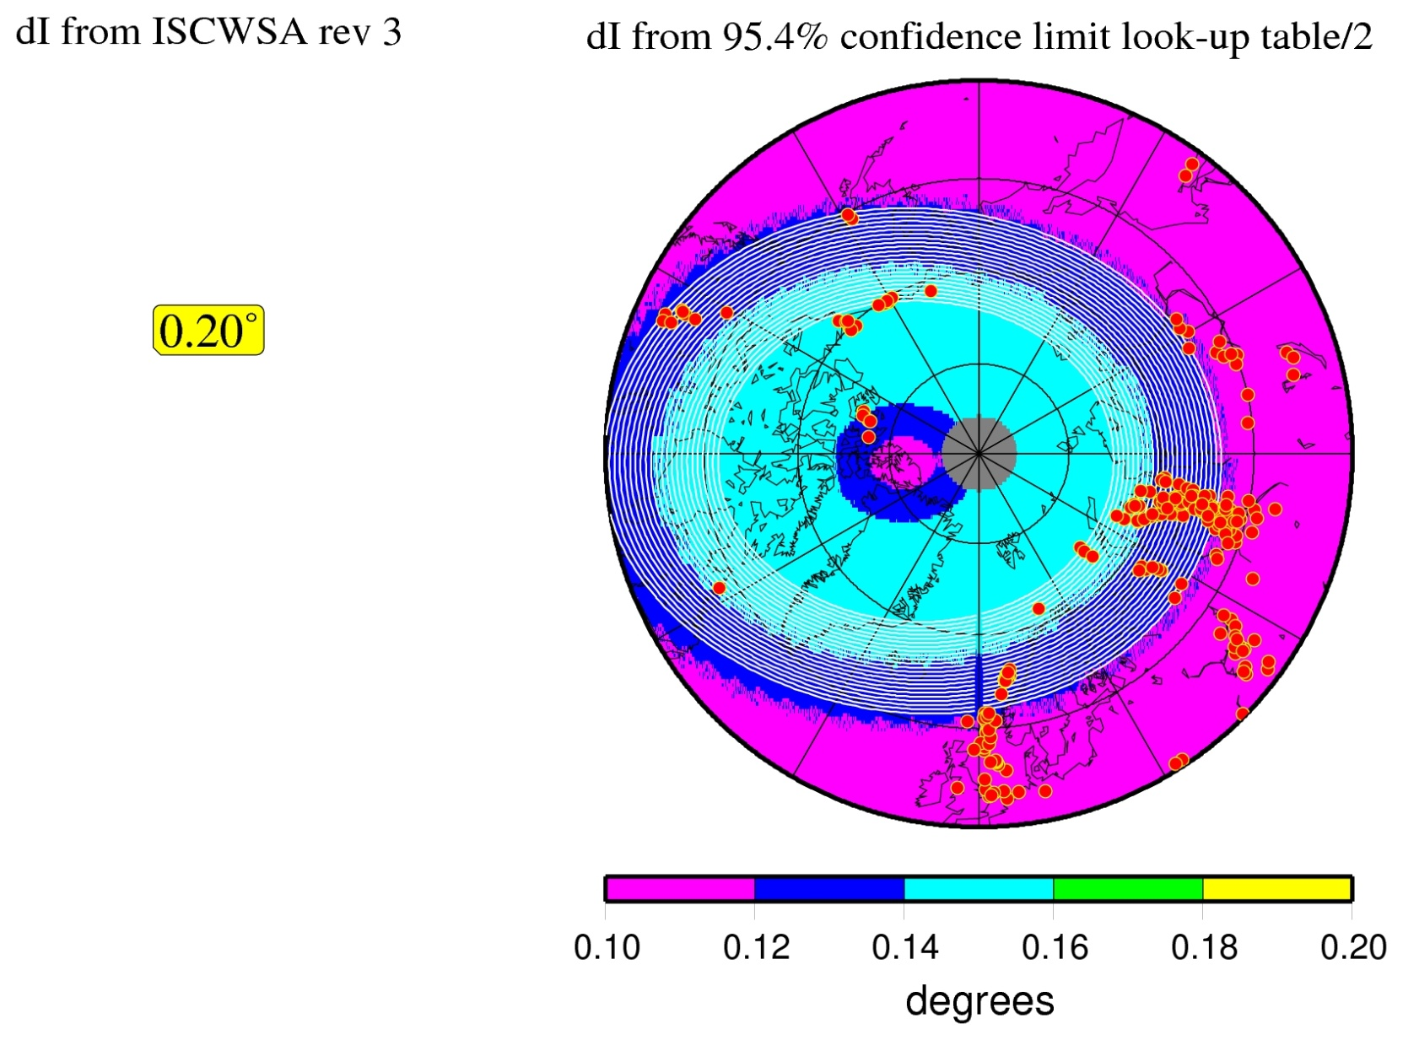
Zoom in again on N polar region…
Too high, excludes effects of polar current systems
Common colour scale

Slide 10
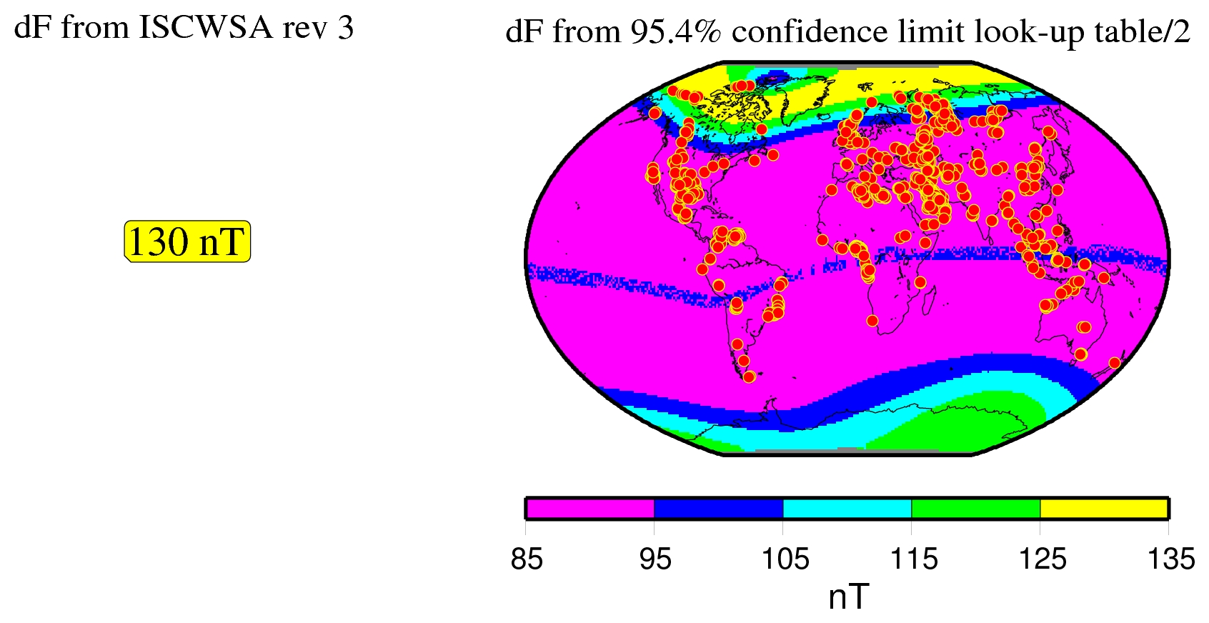
Why one value for Btotal term not good…
Mostly too high, excludes effects of equatorial and polar current systems

Slide 11
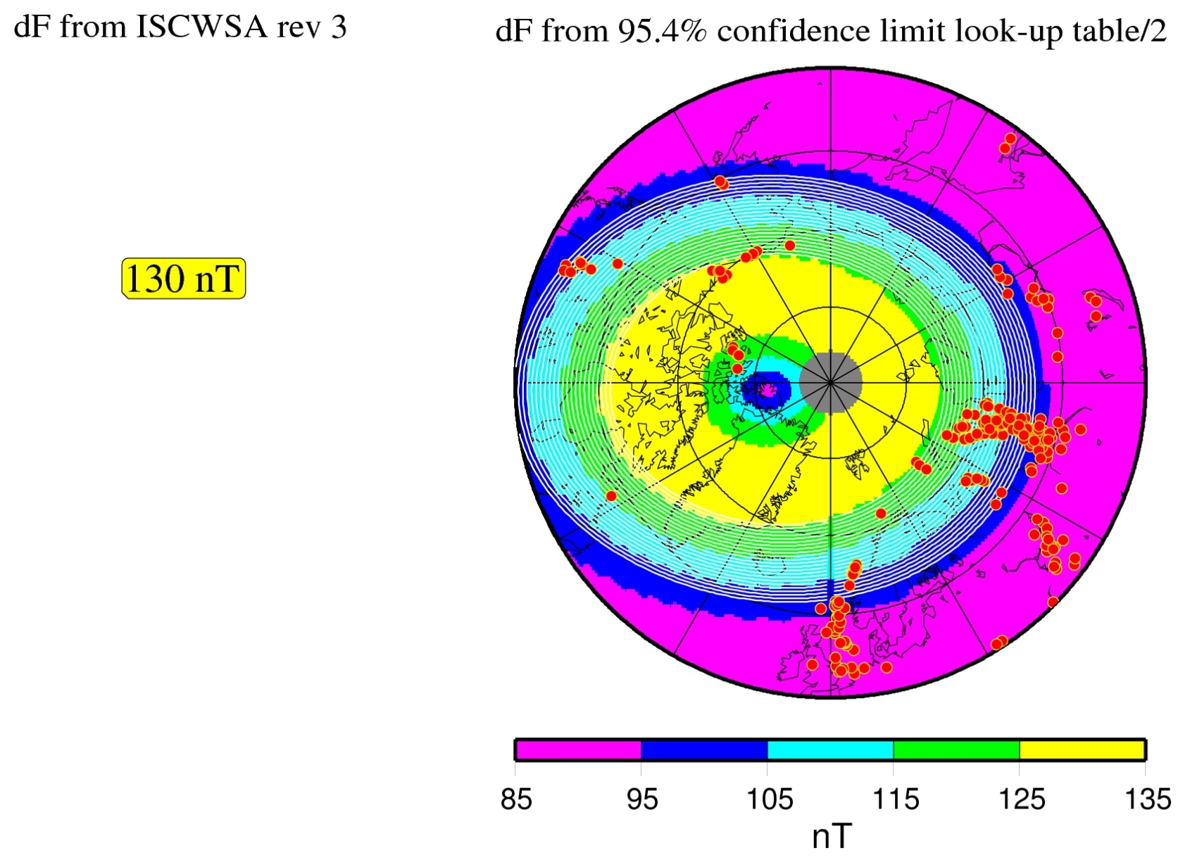
Zoom in again on N polar region…
Too high, excludes effects of polar current systems
Common colour scale

Slide 12
The case
1 term for declination/magnetic azimuth (DEC)
+1 term for magnetic dip (MDI)
+1 term for Btotal (MFI)
= 3 terms (reduction from 4)
Values for MWD terms to depend on location and could come from look-up table associated with global model being used (BGGM, HDGM, IGRF, WMM)
This would allow a substantial reduction in values for many locations
  0.0°-0.3° low/mid-latitudes, up to 1.7° at high latitudes for declination
  0.04°-0.10° for magnetic dip
  -5 nT to 45 nT for total intensity (note increase at some locations)

Slide 13
Other considerations
Values for MWD + IFR1, MWD + IFR2 terms also depend on location
Could come from error assessments in IFR set-up reports which depend on
  data quality and method used for estimating the local crustal magnetic field vector (IFR1 and IFR2)
  local disturbance field climatology (IFR1 and IFR2) including effects over and above those derived from a global analysis
  distance and azimuth to nearest observatory and geomagnetic latitude of drill site (IFR2)

